Slide 1
Some golden rules of magazine cover design

Slide 2


Put the magazine name in the most obvious place

Slide 3
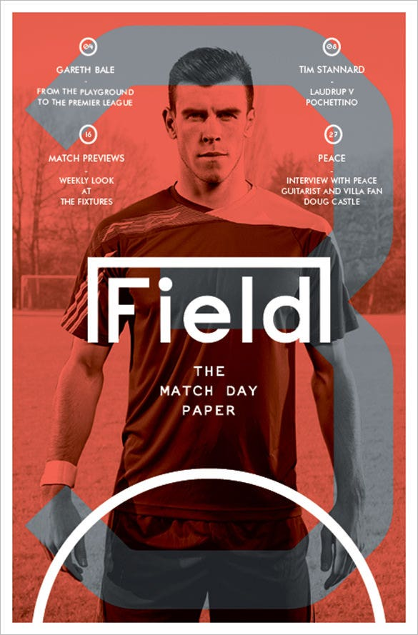

Decide on a focus point and build everything else around it

Slide 4
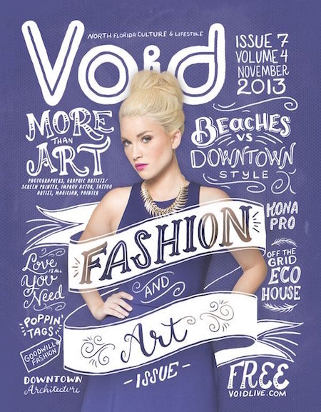
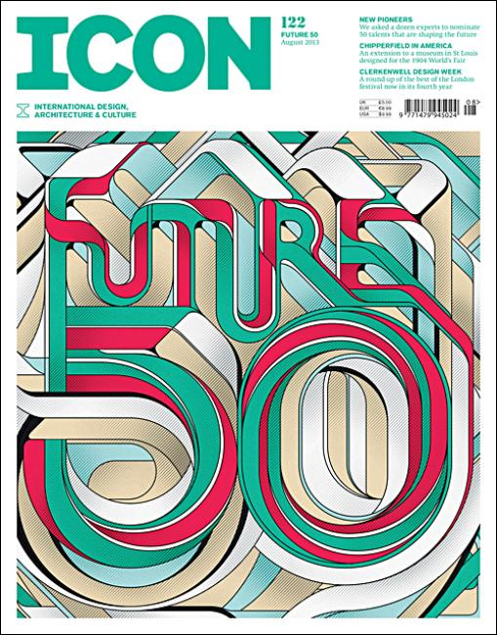
Play with font styles

Slide 5
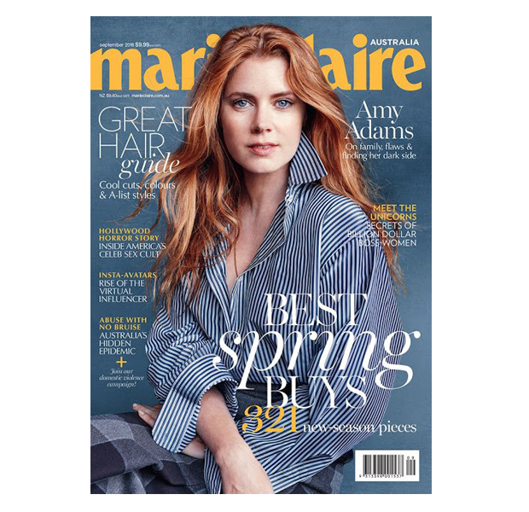
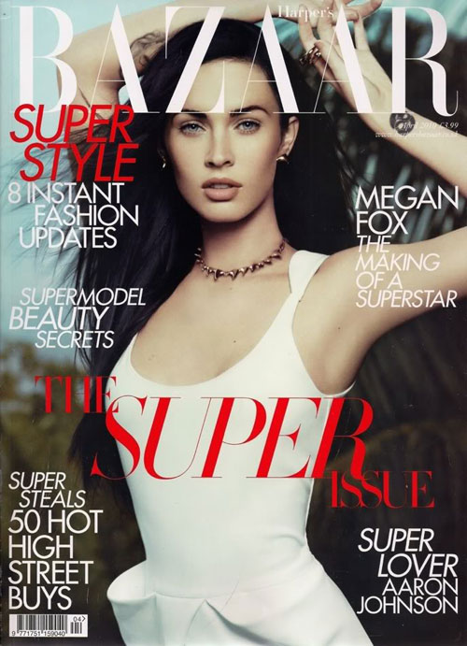
Emphasize powerful words

Slide 6
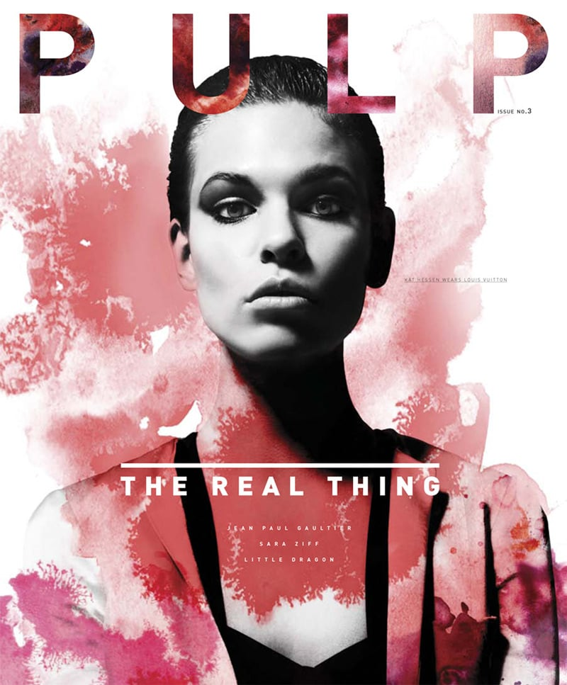
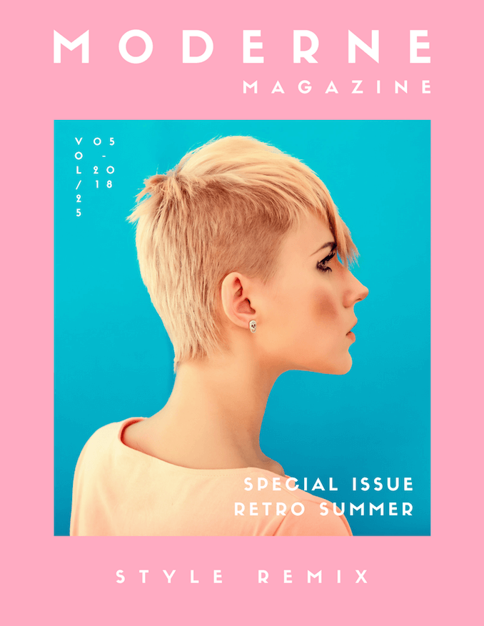
Infuse your magazine cover design with a healthy dose of color & contrast

Slide 7
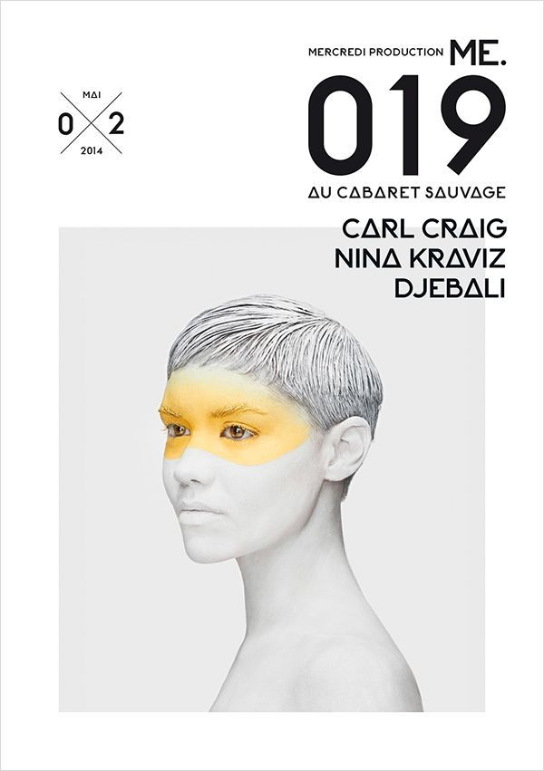
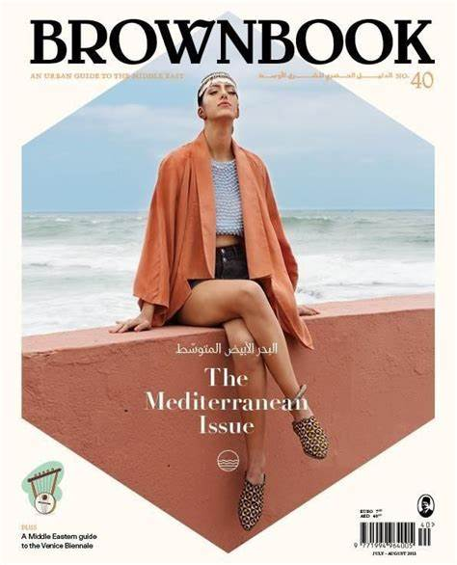
Place a portrait on the cover

Slide 8
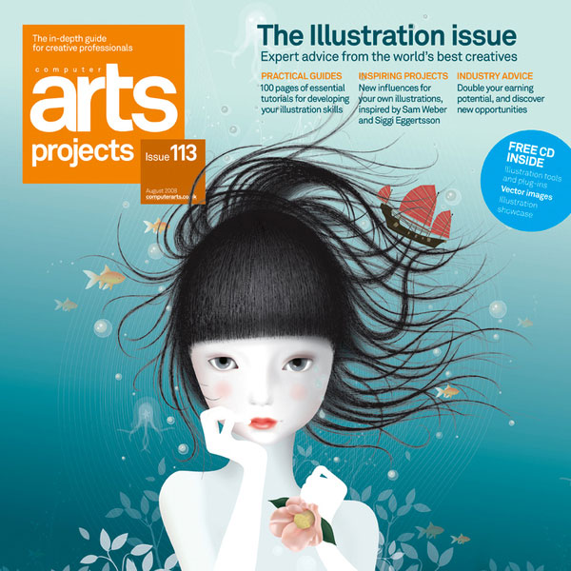
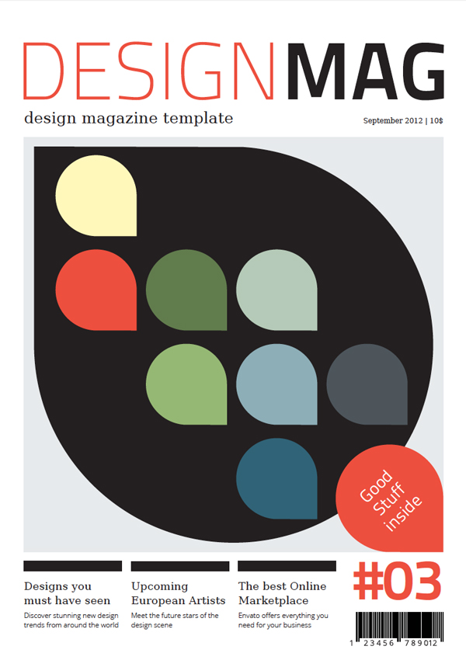
Dare to be bold. Go for illustrations

Slide 9
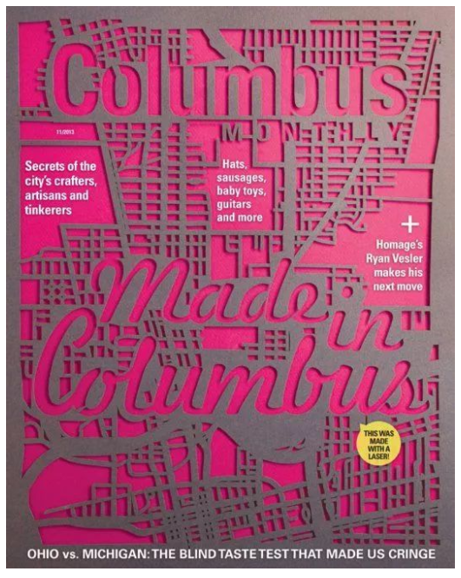
Create a laser cut cover
Overlaying grey the laser cut on a pink background adds dimension with shadows and contrast.

Slide 10
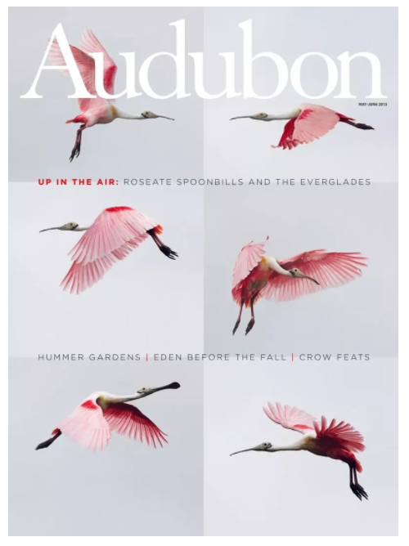
Showcase a sequence
It showcases the color, flight, and movement with minimalist typography aligned to reinforce the grid.

Slide 11
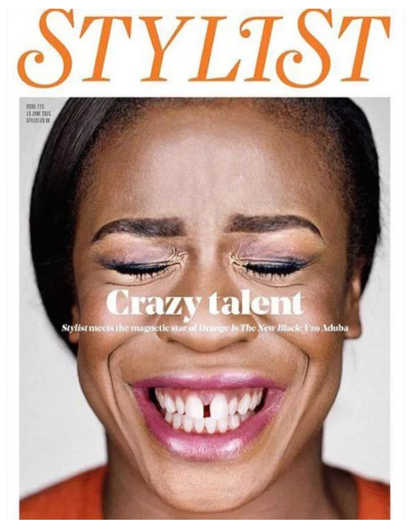
Create impact with imagery
The close up of Aduba’s face – with eyes squeezed shut and grin gap-toothed and joyful – is magnetic and jubilant.

Slide 12
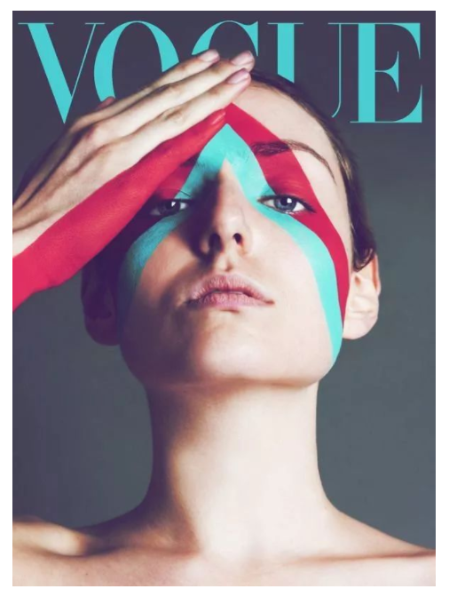
Play with face paint
This Vogue cover with bold lines and angles that traverse the model’s face and hand. Although she executed it digitally, the red and turquoise strips look like face paint with colors that match the masthead.

Slide 13
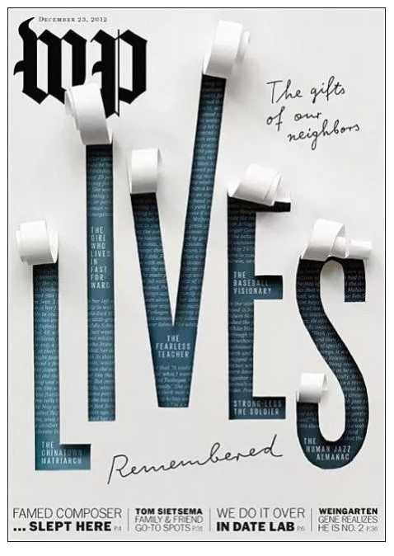
Create illusions with paper
‘Lives Remembered’ tells the life stories of people who passed away in 2012.

Slide 14
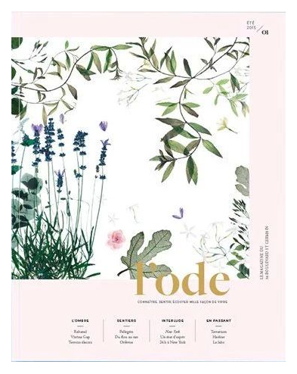
Nothing wrong with pretty and sweet
A pretty and sweet aesthetic often goes against the grain in the world of magazine covers where being bold is eye-catching.

Slide 15
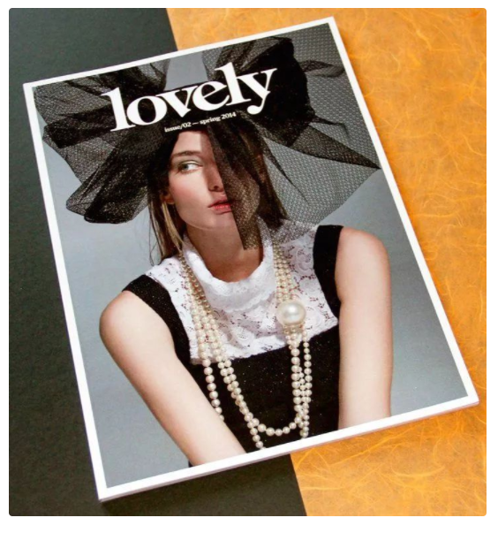
Avoid eye contact
While the models on most magazines look directly at the viewer, the model on this cover of Lovely is giving a sideways glance that—along with the fashion styling—adds quirkiness and eccentricity.

Slide 16
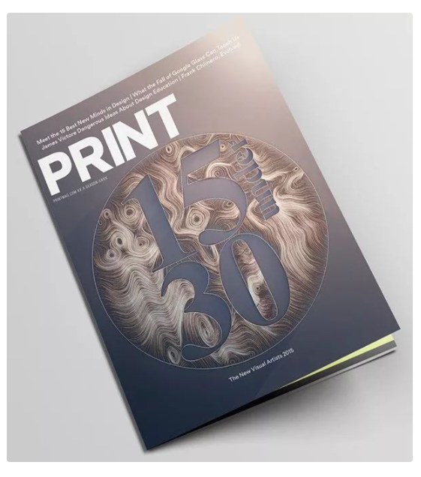
Fake a light source
The designer used a gradient on the background to give the appearance of a light source hitting the top right-hand corner adding a sense of dimension to the cover.

Slide 17
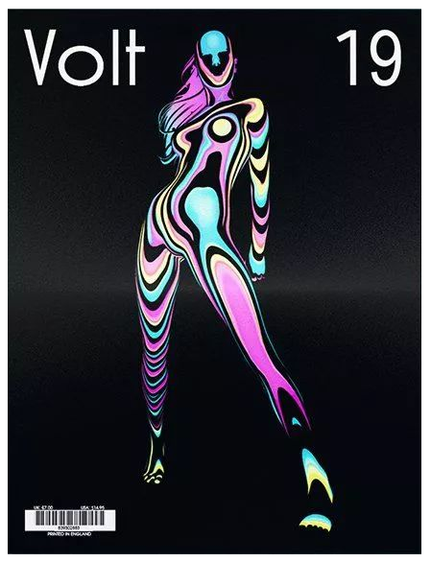
Experiment with psychedelic colours
Illustrator Matt Corbin played with bright psychedelic colors and globule-like forms to create the image of a strong woman posed against a shiny black background.

Slide 18
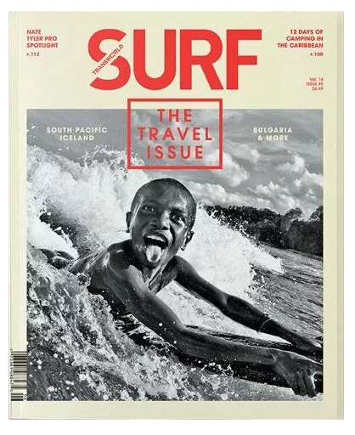
Use a cheeky photo
It’s hard not to be attracted to this cover of Surf featuring a young boy poking his tongue out at the camera. It is, in the words of Wedge & Lever, “sophistication that does not take itself too seriously.”

Slide 19
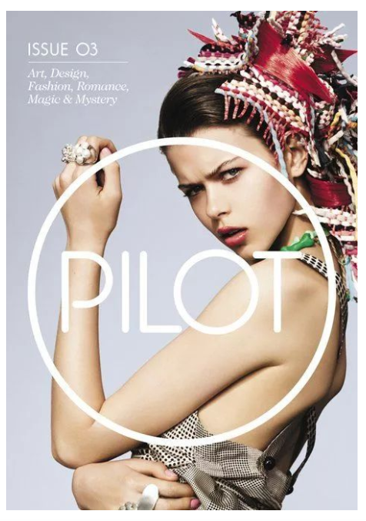
Centre the masthead
This cover of Pilot, gives the masthead pride of place in the center of the cover. It also works like a bulls-eye as the encircling O is the same as the smaller O in ‘Pilot’ and the model looks straight through it.

Slide 20
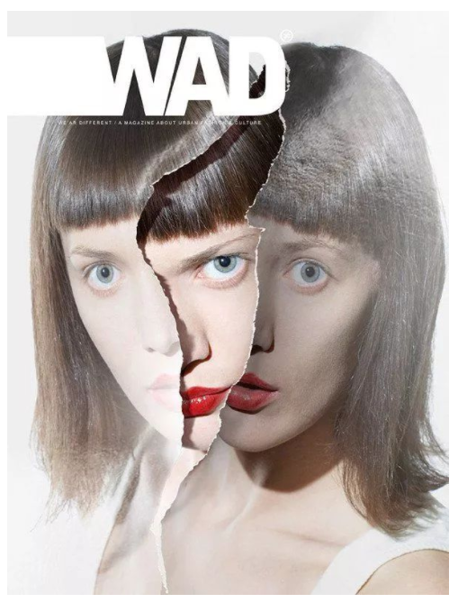
Tear it up
This cover of Wad uses the illusion of a model’s face torn in two to reveal another image of her face, perhaps trapped, perhaps empowered. Three eyes peer out at the potential consumer.

Slide 21
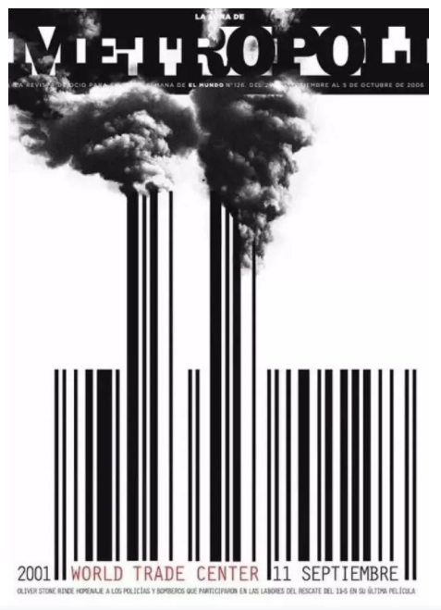
Make a statement with the barcode
There are few magazine covers where the barcode is such an integral part of the design. On this cover of La Luna de Metrópoli, the barcode is infused in an illustration of the September 11 attack on the World Trade Center.

Slide 22
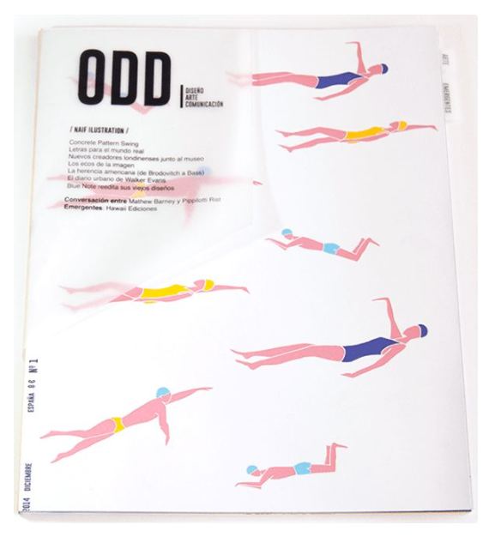
Layout a series of simple illustrations
Simple illustrations, a minimal color palette, and a white background combine in this striking cover for Odd.

Slide 23
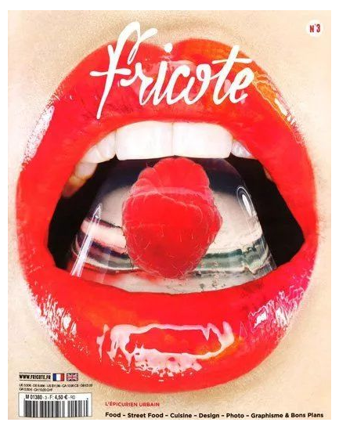
Get ready for an extreme close-up
This cover of Fricote features an extreme close up of a red-lipped mouth holding an ice-clad raspberry in its teeth. The glossy lips and the shiny ice cube boost the high-end factor of this cover.

Slide 24
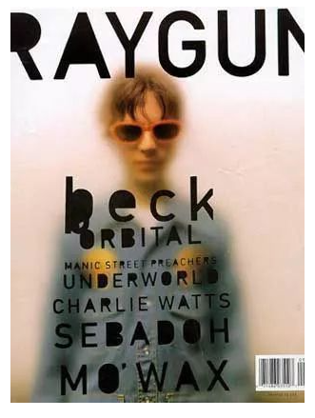
Contrast a blurred image with crisp lines
On this cover of Ray Gun he overlays a blurred, almost steamy, image of Beck with strong black typography made all the bolder with the holes of each letter filled in.

Slide 25
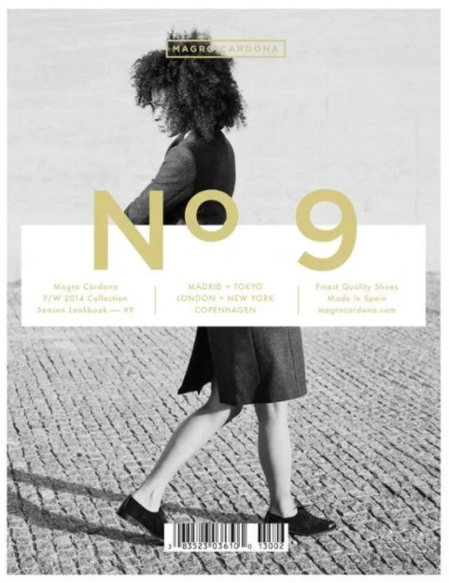
Disorient with surrealism
Surrealism prompts the viewer to question “what the…?!” as this cover for Magrocardona demonstrates. The image is of a model split in two; her head and torso faces away from her legs and feet walking in the other direction.

Slide 26
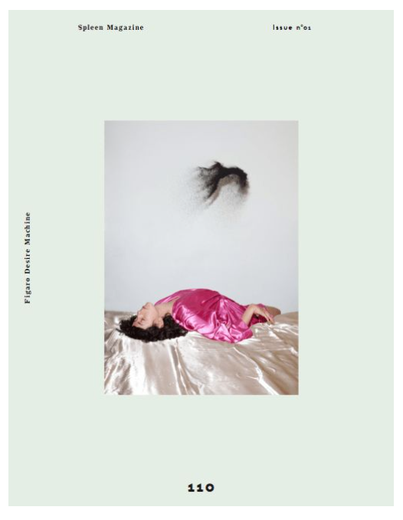
Use an extra wide frame
This cover of Spleen uses an extra wide frame – or a small picture, depending on which way you want to look at it – to draw attention to the central image. The title, issue number and theme of the magazine are placed sparingly along the edges.

Slide 27
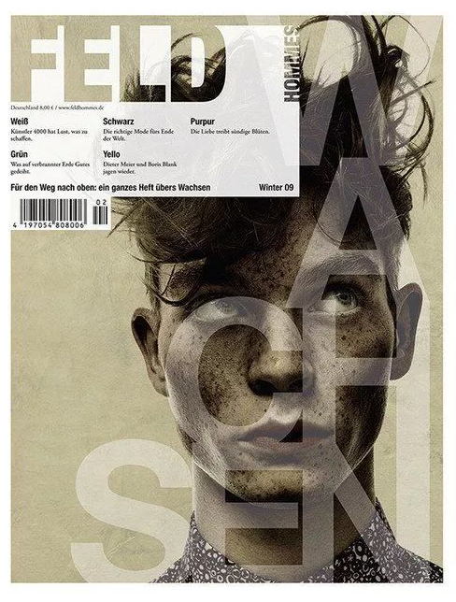
Muster nostalgia with sepia tones
You’ll find a lot of interesting design techniques on this Feld cover including blocky typography, transparencies and a quirky image.

Slide 28
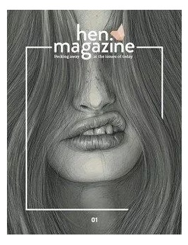
Use a frame to highlight
A disjointed and broken white line frames the model’s mouth on the cover of Hen Magazine and it serves to highlight and draw attention to her cheeky sneer.

Slide 29
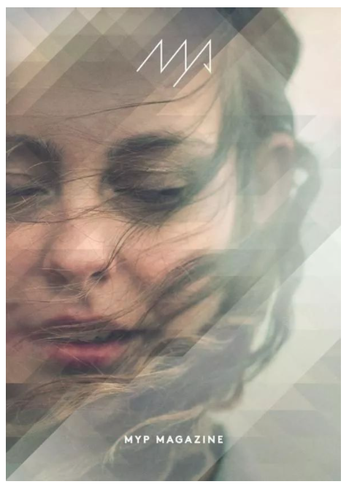
Add depth with a geometric transparency
A geometric pattern with varying levels of transparency is laid over the image of a wind-blown model and adds varying depths to the image.

Slide 30
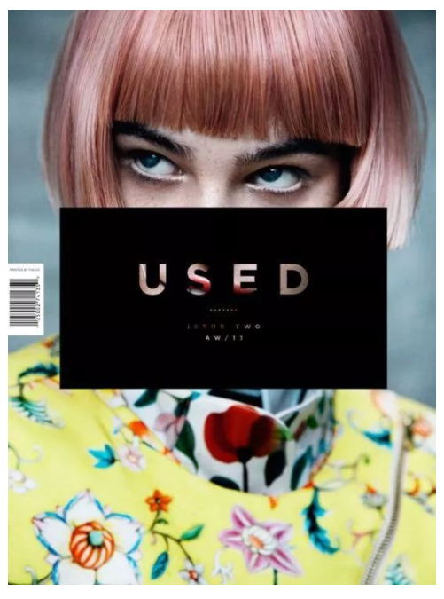
Explore negative space
This Used cover explores negative space by slicing the masthead from the solid black box in the center of the page.

Slide 31
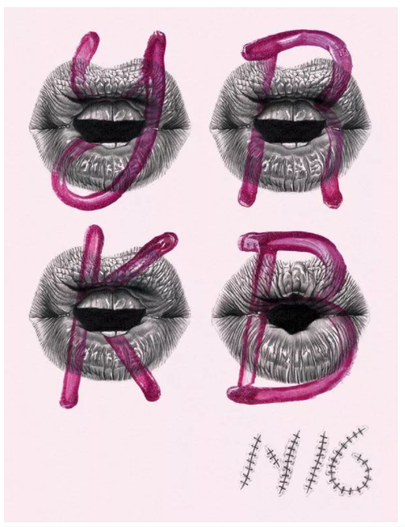
Use hand-drawn techniques
The cover used only pencil and lipstick to create this cover of Yorokubu. It overlaid a pencil illustration of lips with letters drawn in lipstick and repeated the pattern four times, each with a different letter.

